Slide 1
Library Management System Coursework 1
Muhammad Ahmed
M00898450

Slide 2
About the Task
The Library Management System is designed to streamline book borrowing, returning, and member management.
The implemented system ensures organized handling of books, members, and transactions.
Object-oriented design with classes like Book, Member, Librarian, etc.

Slide 3
Class Hierarchy
The system defines several classes, including Date, Person, Member, Book, and Librarian.
Date class handles date-related operations.
Person is a base class for Member and Librarian, encapsulating common attributes like name, address, and email.
Member class represents library members, storing information such as member ID and a vector of borrowed books.
Book class represents library books, containing details like book ID, title, author, due date, and borrower.
Librarian class extends Person and includes additional attributes like staff ID, salary, and vectors for storing members and books.

Slide 4
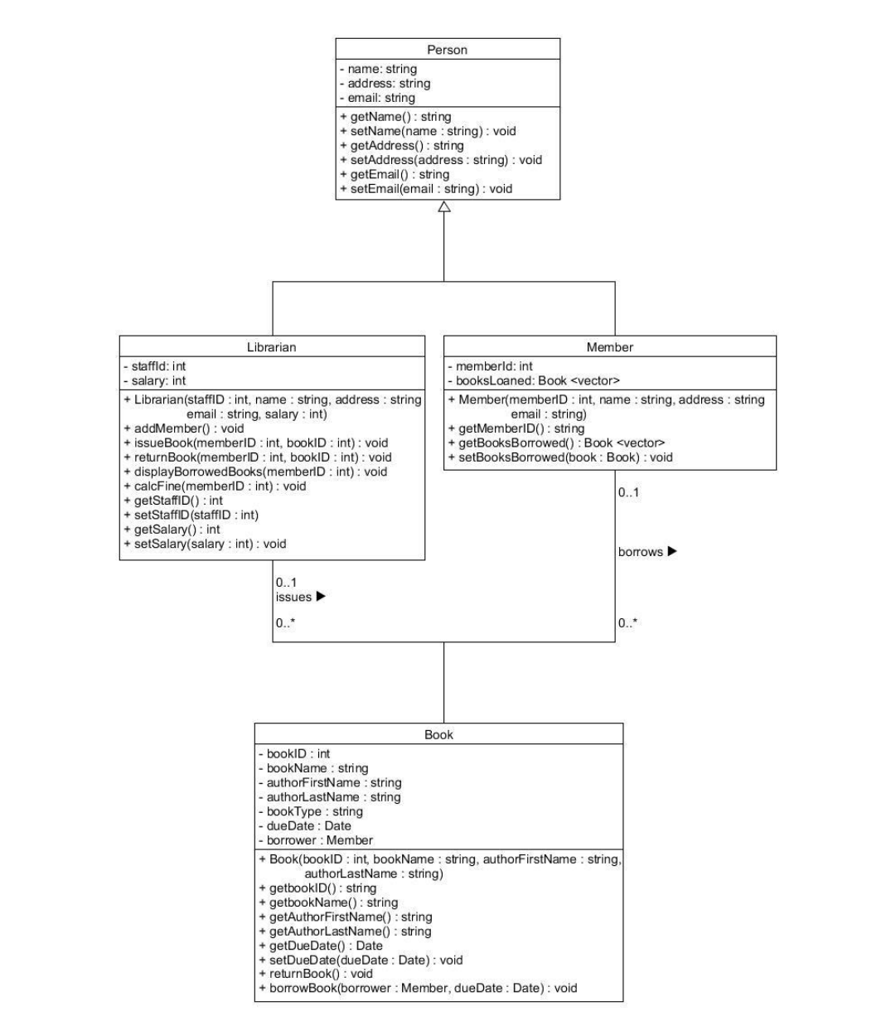
UML design around which the program is based.

Slide 5
Implementation
Keeping the UML diagrams in mind, first, all the classes were declared, followed by getter and setter methods.
Any necessary functions were carefully thought on how they would help achieve the desired outcome.
Not much of commits were done during the process because I was having some problem pushing code to git repo which I figured out just a few days before deadline.

Slide 6
Data Types
Used vectors to store members (and their details).
Used vector to store the books (along with book id, author name, book name etc) when reading in from the .csv file.
Mainly string and integer is used for basic manipulation of data.

Slide 7
Functions/Methods
Member Creation: librarian uses createMember function to add a member with details such as name, email and address.
Issue Book: librarian can issue book to the member choosing from a list of books.
Check Borrowed Books: librarian can check for every(one at a time) member that how many books that member has borrowed.
Fine Calculation: if a book is past its due date, librarian has the control to check which member has gone past the due date to collect fine from them.

Slide 8
Algorithm
When you run the program it gives a menu like interface to let user select what they want to do then with each input they are assisted with commands that make it easier for the user to use the system without knowing much about how the program is coded or how things work in the back end of the system.

Slide 9
Testing
Due to personal reasons, I ended up with less time for myself to work on this project. So the testing part of the system hasn’t been done with authority.

Slide 10
Future Use
This program is quite solid when comes to functionality so I believe in future tasks, learning outcome of this coursework will be a lot helpful.
Be any task, the approach would remain the same ie. To understand fully what the task requires and don’t get carried away trying implementing things which are not necessary or have lower priority.

